Slide 1


Practical Guide for Building a 3D Web App from 2D Data
Kristian Ekenes
Raluca Nicola
2019 ESRI DEVELOPER SUMMIT
Palm Springs, CA
Notes:
G243257 DevSummit 2019 Template for Esri staff

Slide 2






Kristian Ekenes
Raluca Nicola
Product Engineer JS API
Product Engineer JS API
Data visualization, Smart Mapping, Arcade
Data visualization, 3D
Redlands, California
Zurich, Switzerland
Notes:
Not sure if this slide is worth it. We present ourselves anyway

Slide 3
You will learn
Notes:
Motivation – why are they here

Slide 4

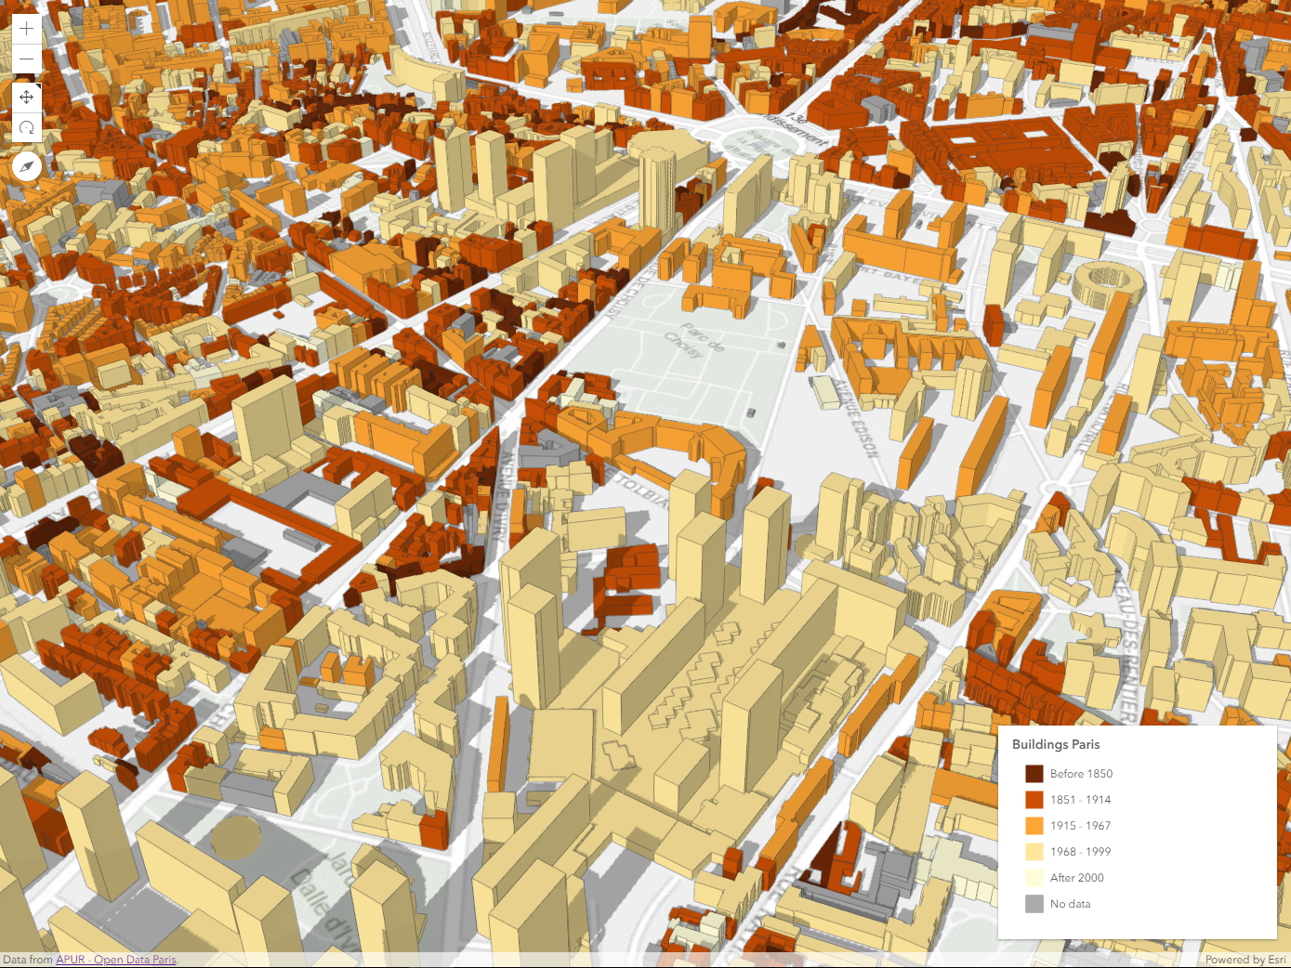
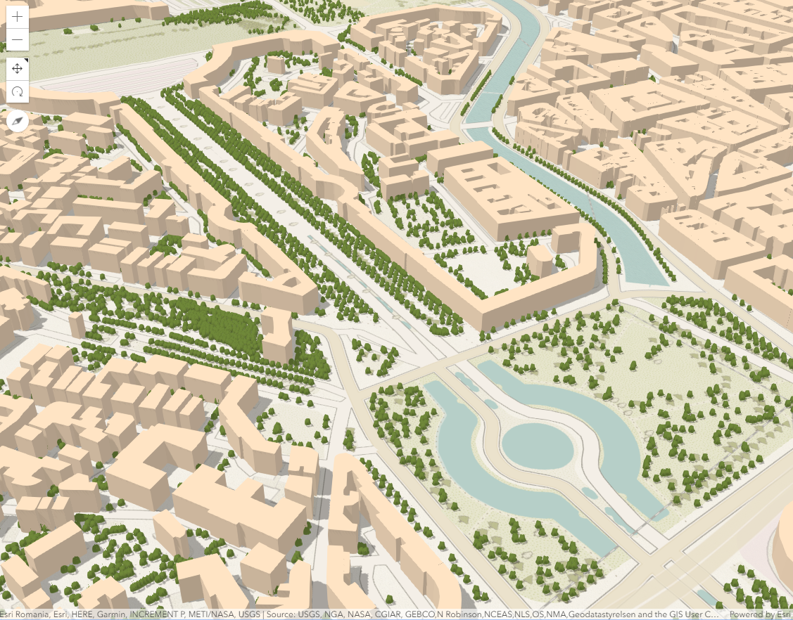
how to create city visualizations
using polygon extrusion and web styles
Notes:
Motivation – why are they here
They’ll learn how to visualize data like this

Slide 5
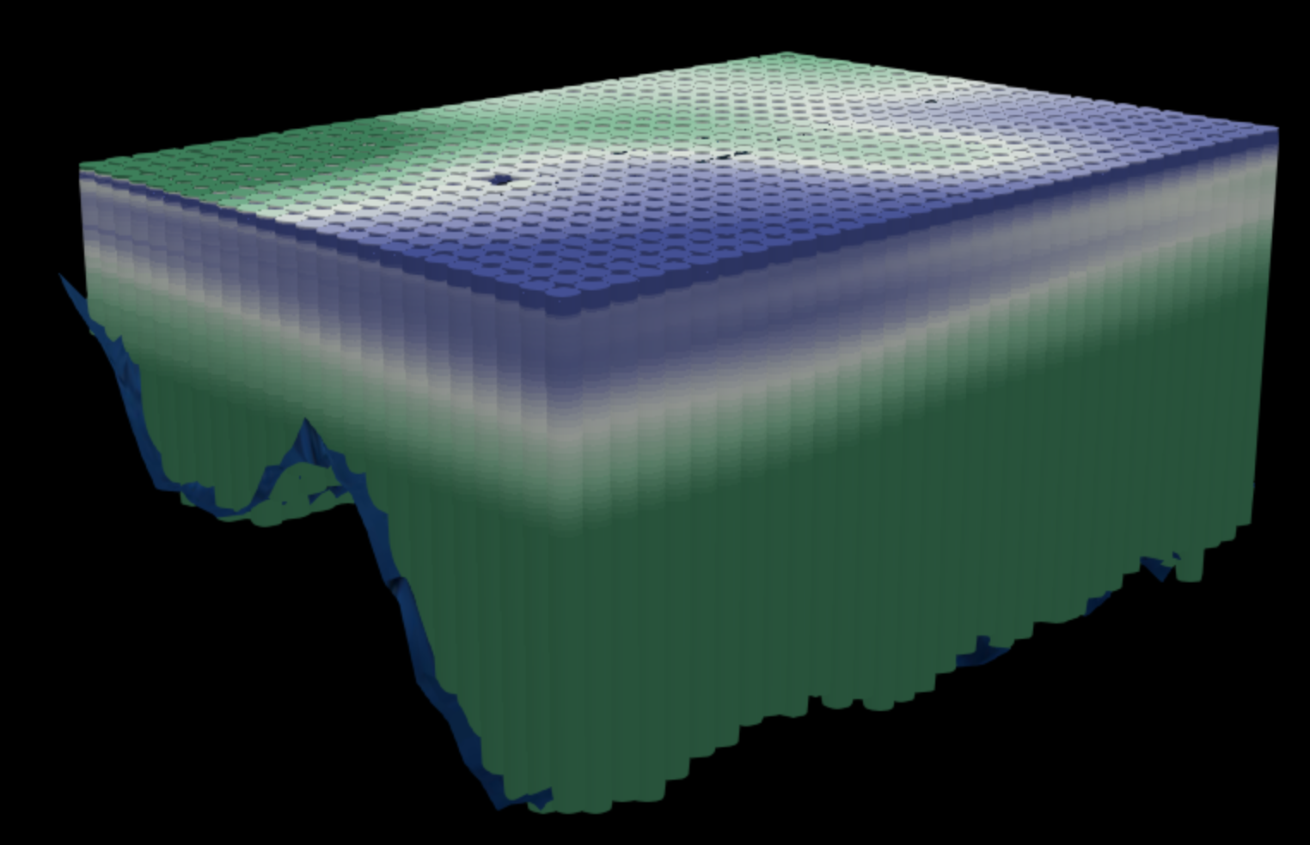
how to visualize scientific data
using z values from attributes
Notes:
Motivation – why are they here
They’ll learn how to visualize data like this

Slide 6
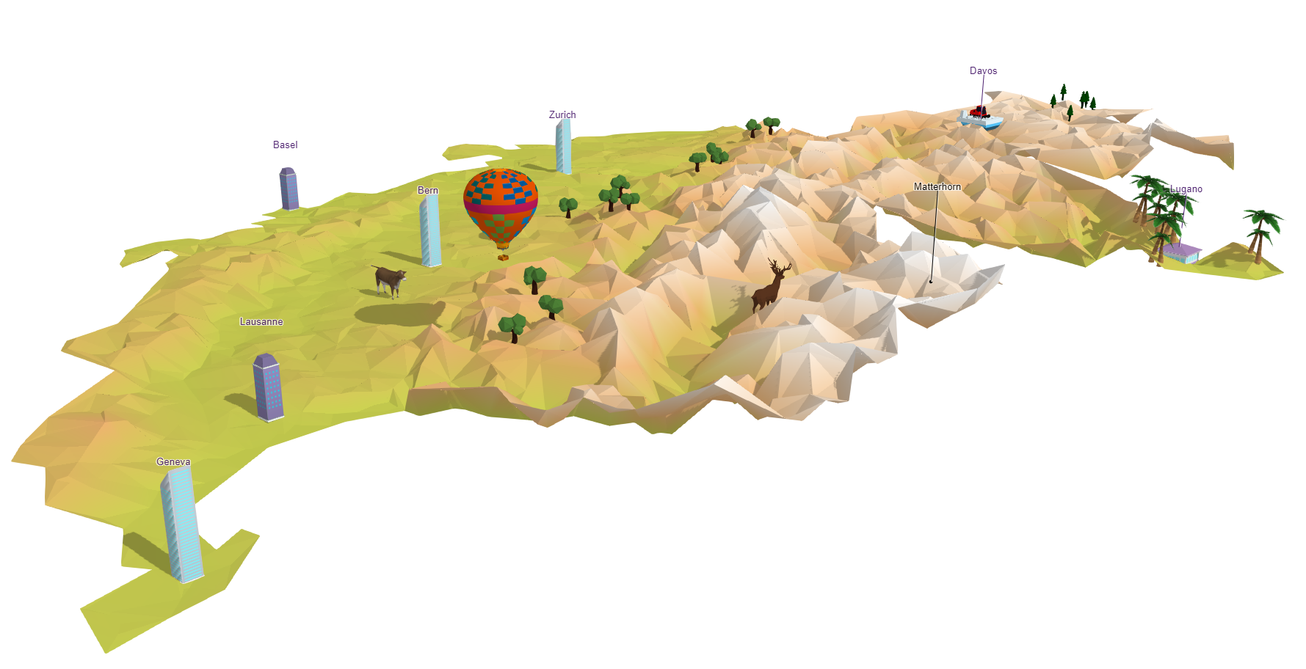
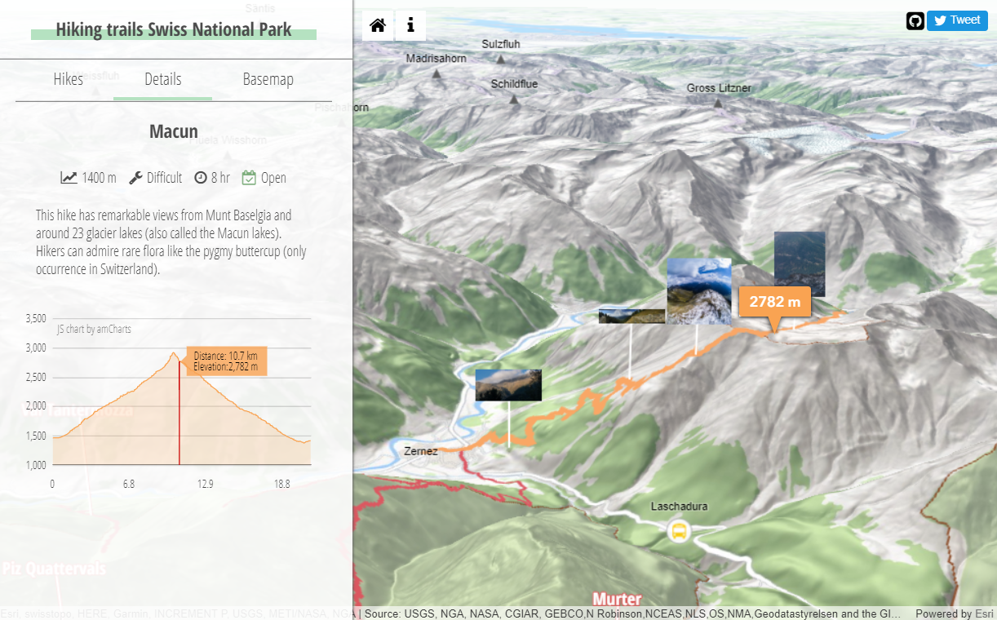
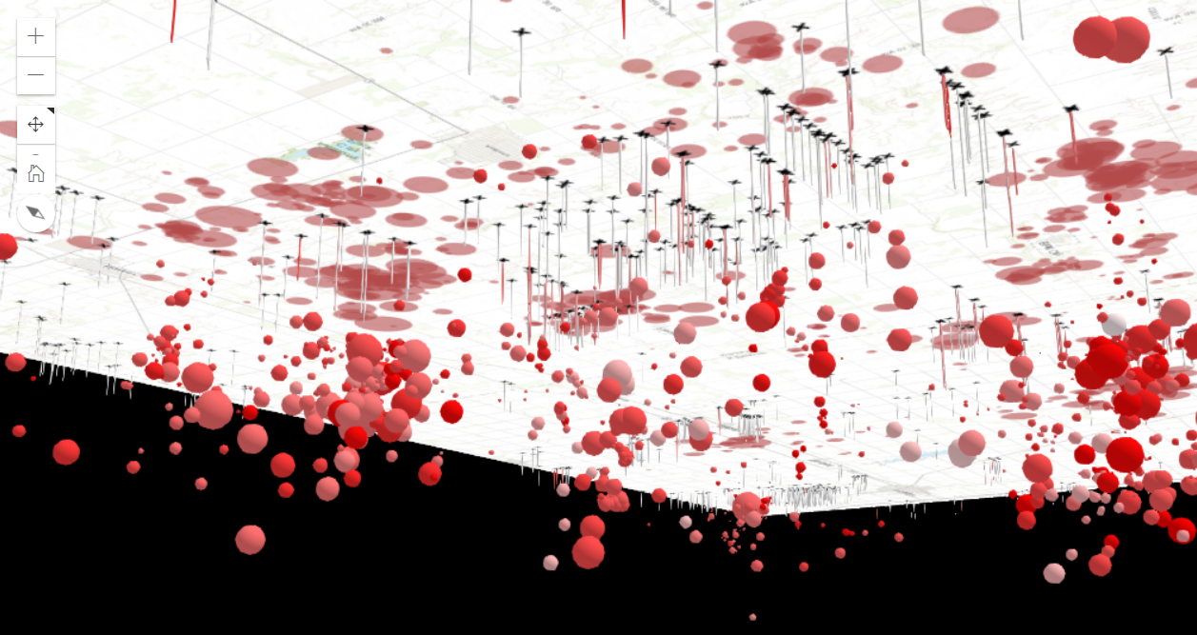
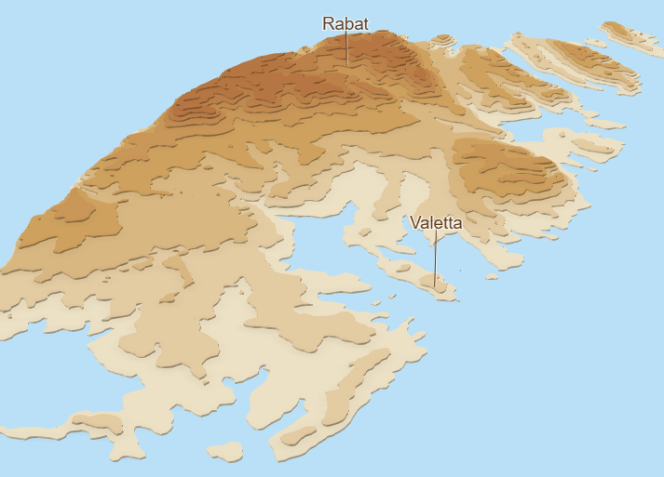
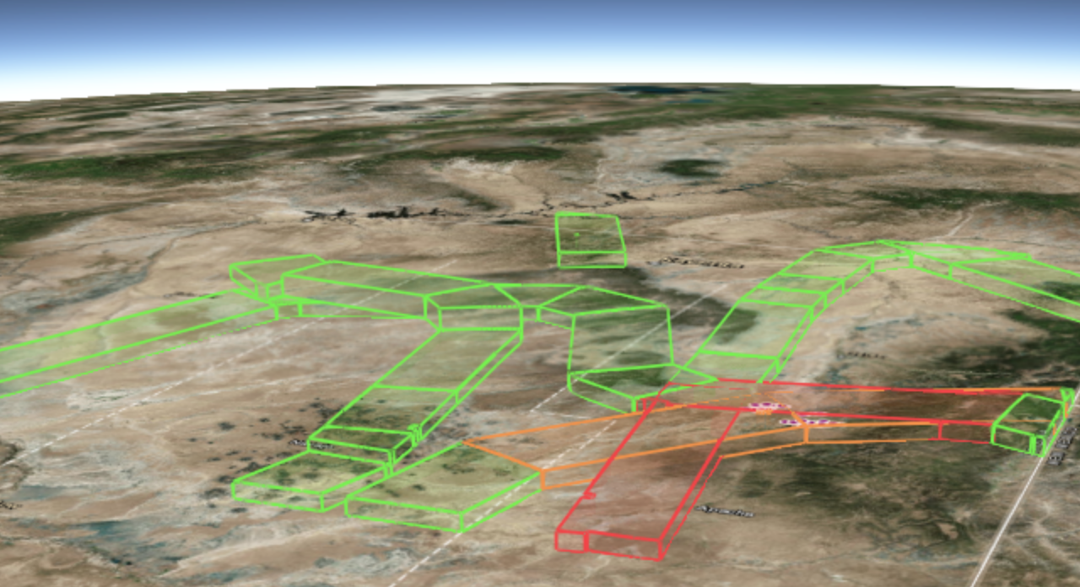
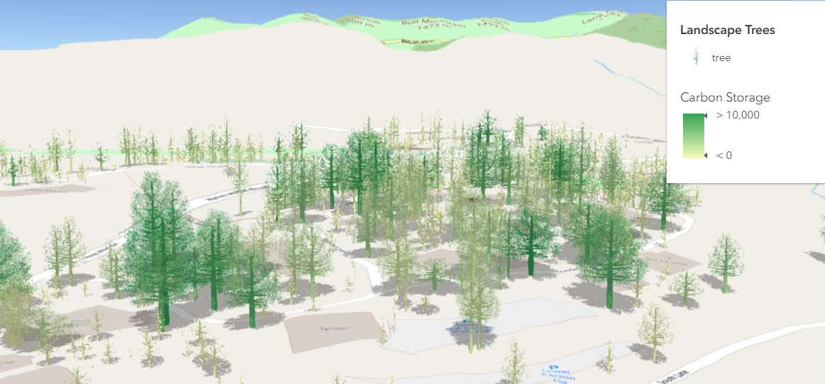
and some other examples

Slide 7
Marine data analysis
City visualizations
Other visualizations
15 min
15 min
20 min

Slide 8

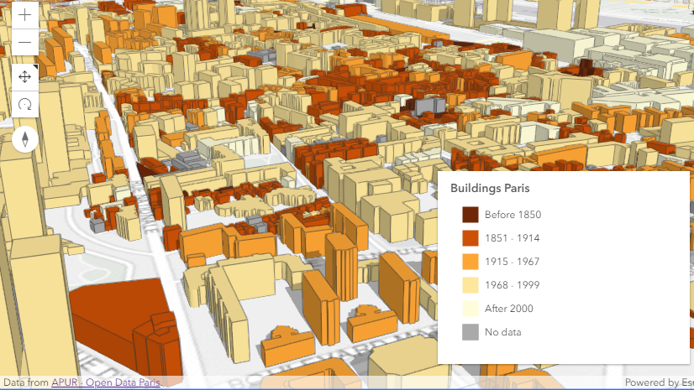
City visualizations
Cities in Romania – using OSM data
Paris – using open data

Slide 9
Resources
OpenStreetMap – building footprints & trees
Open Data portals – building footprints
ESRI basemaps & elevation services
ESRI Web Styles
ArcGIS API for
JavaScript

Slide 10
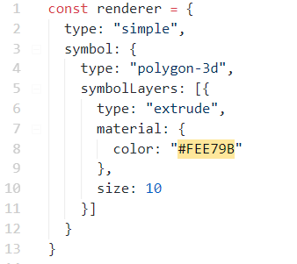



Building footprint extrusion
10 meters

Slide 11
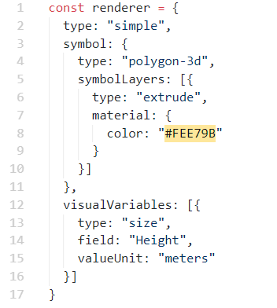
Building footprint extrusion
$feature.Height

Slide 12
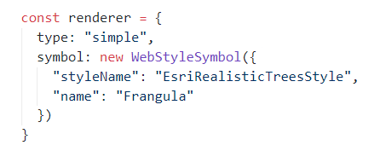
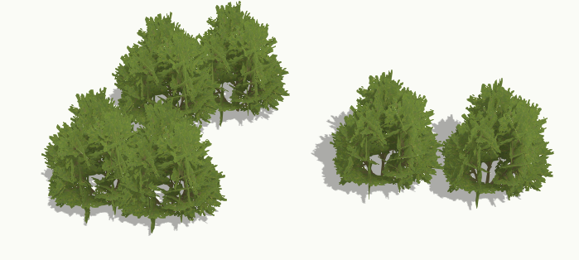
3D models – WebStyleSymbols

Slide 13
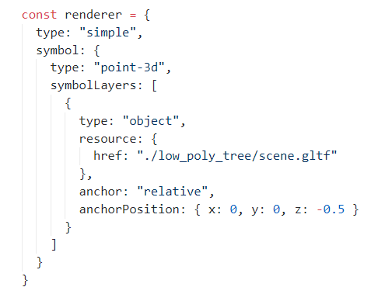

3D models - glTF

Slide 14
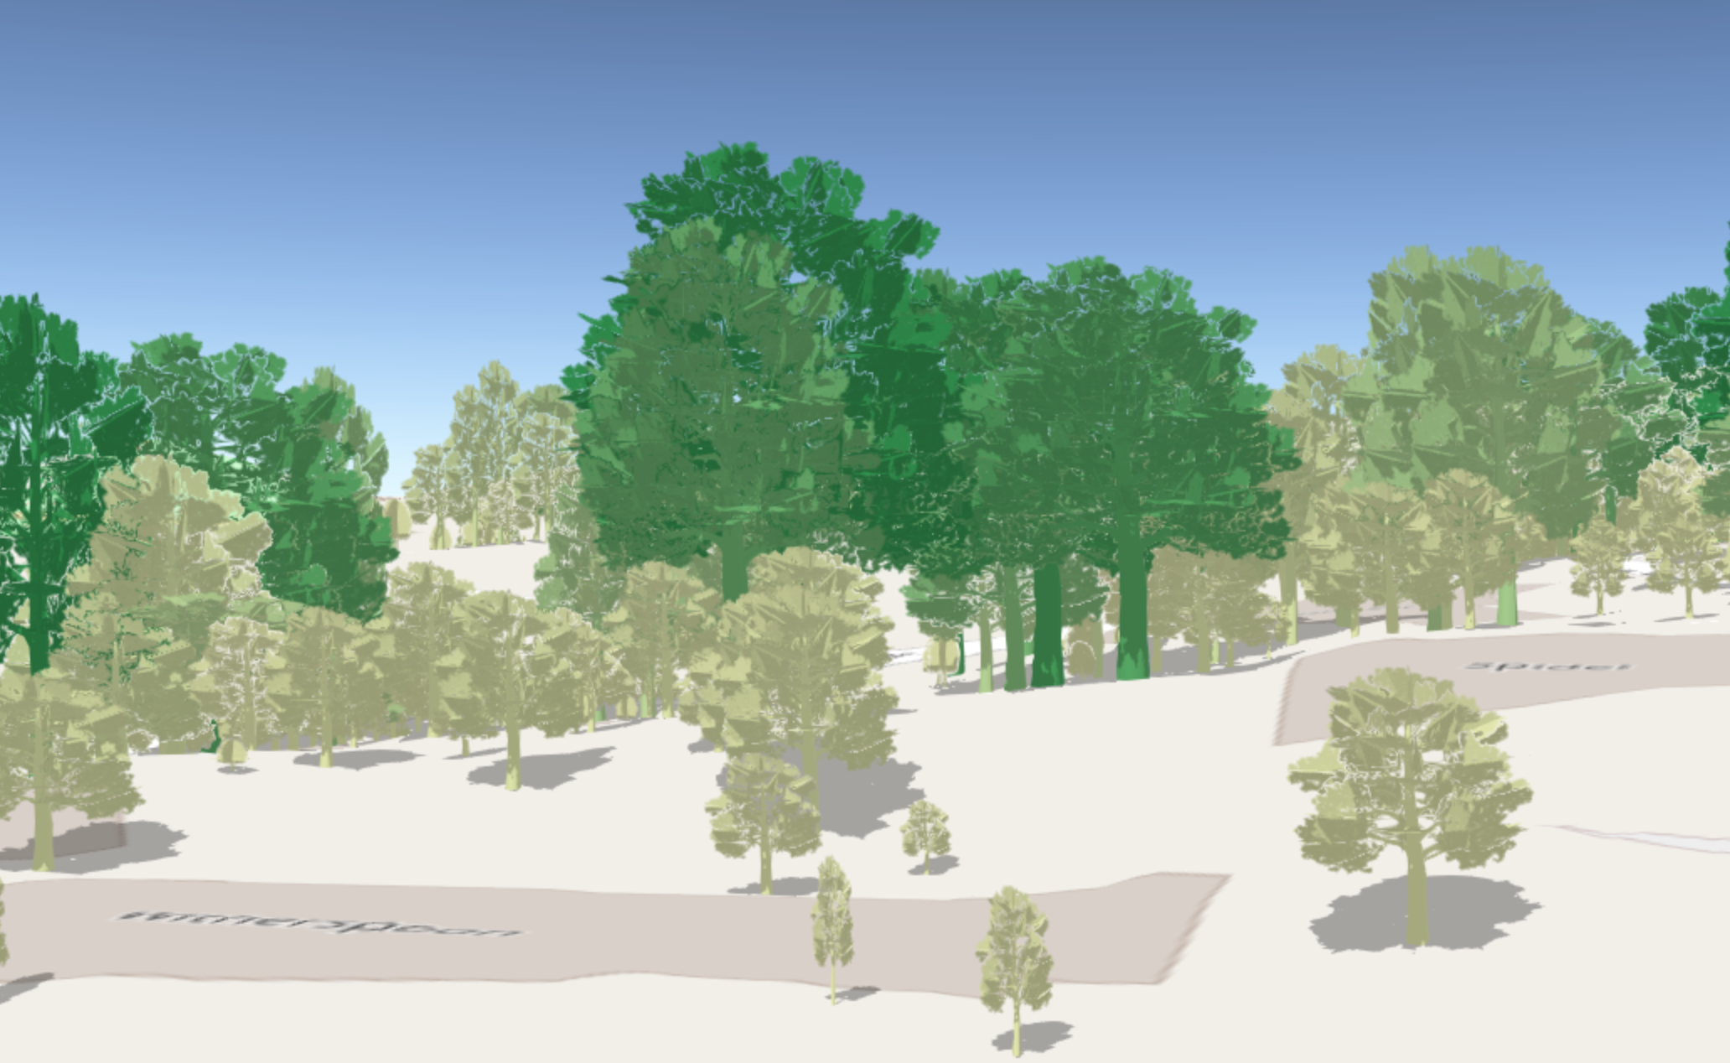
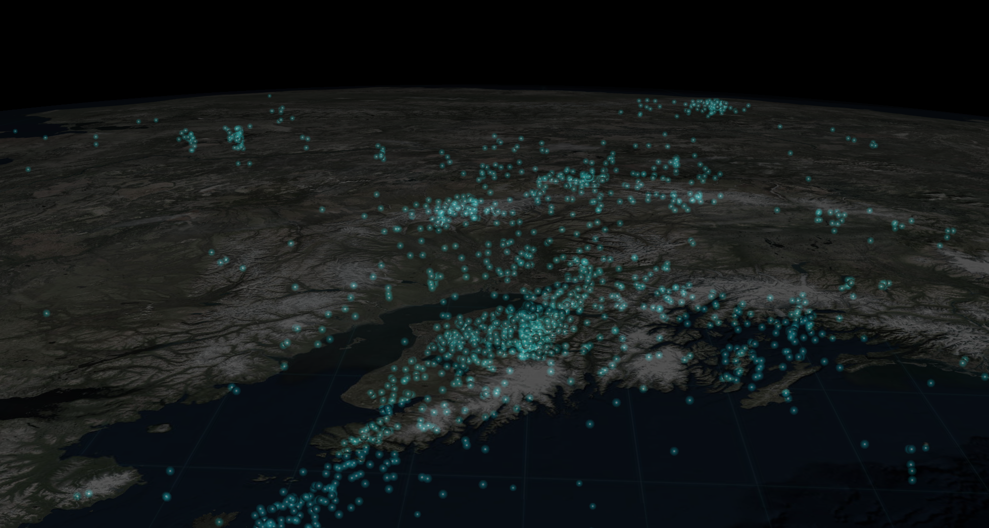
Scaled 3D models

Slide 15
Earthquake visualization

Slide 16
Marine data analysis

Slide 17

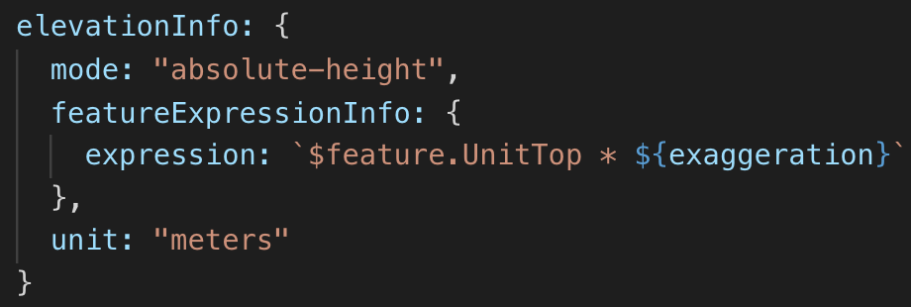
0
100

Slide 18
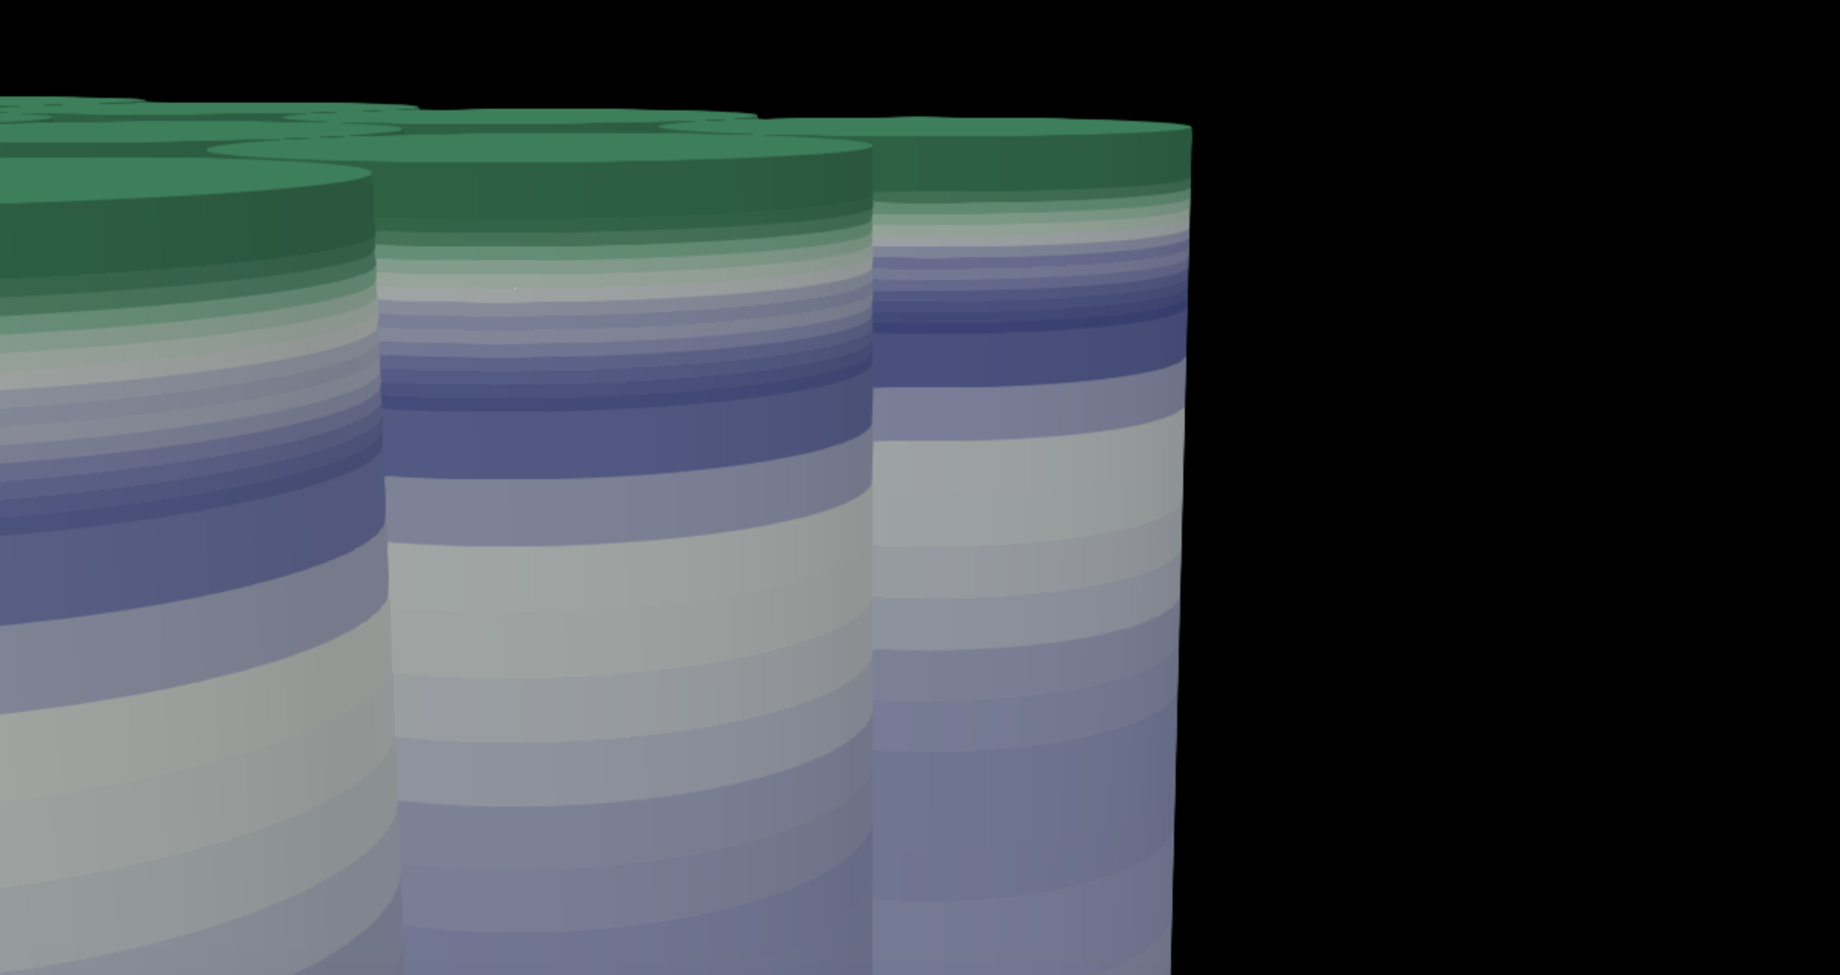
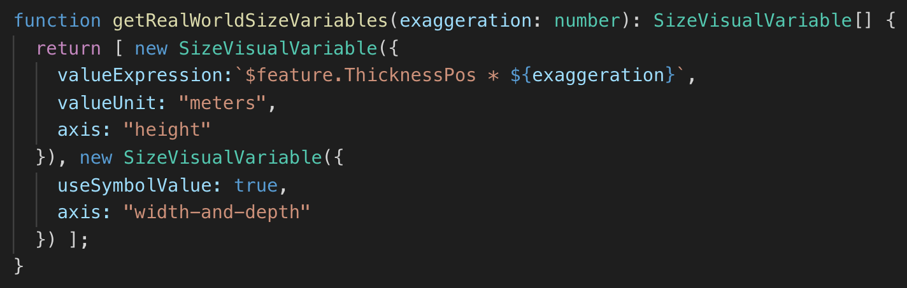

Slide 19
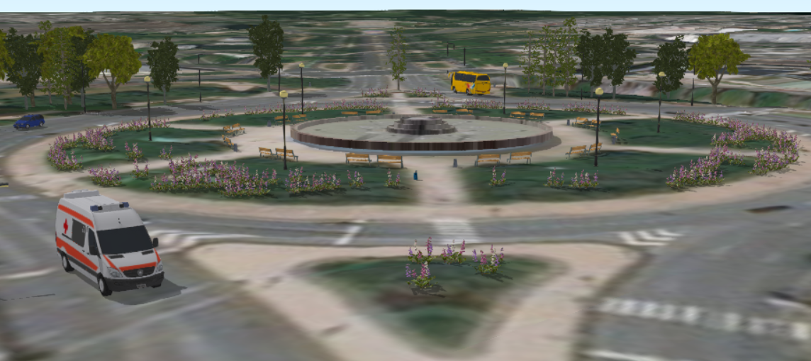
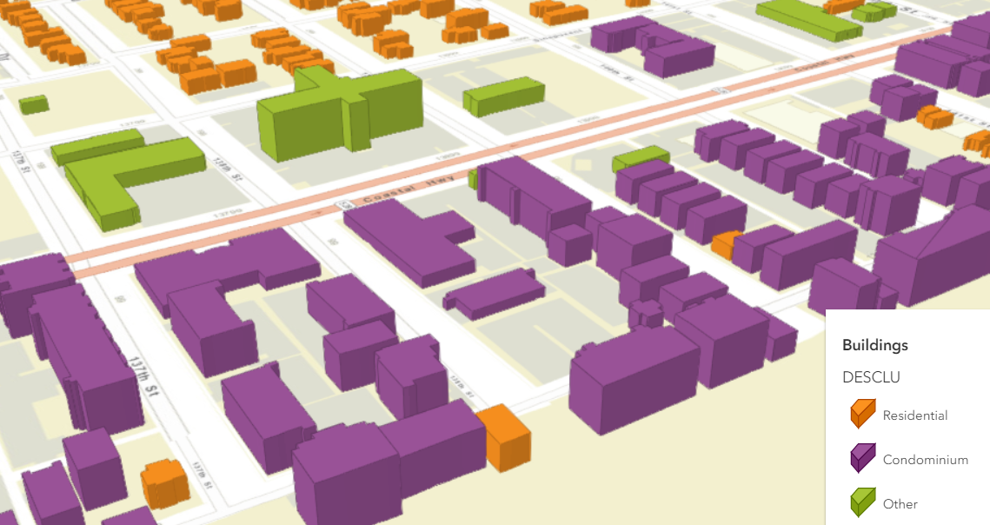
Documentationsamples

Slide 20
Hiking app
Swiss National Park

Slide 21
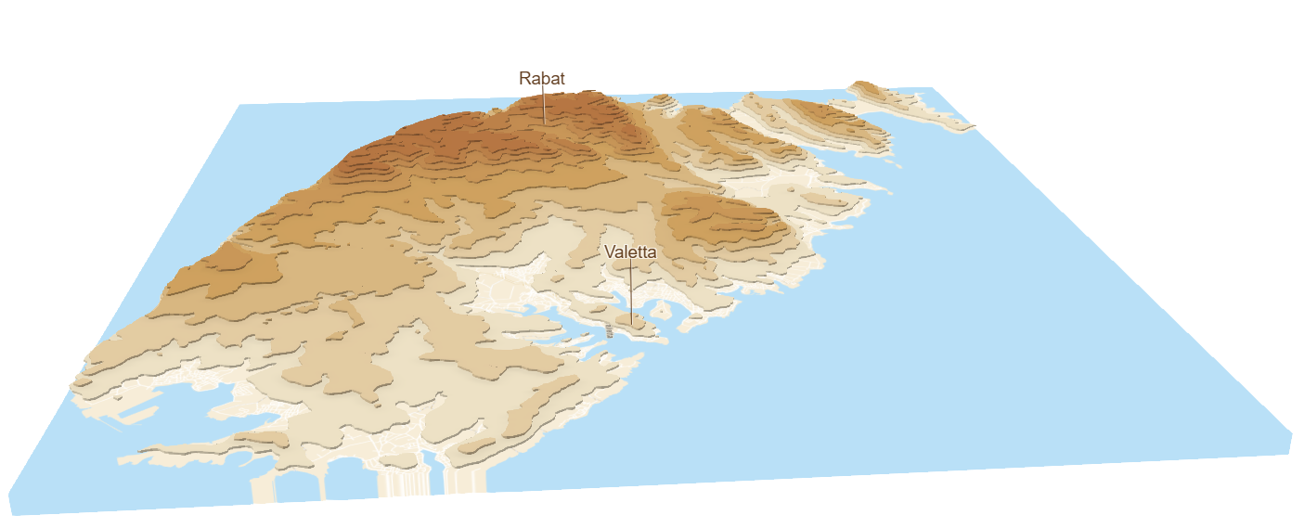
Terrain visualization
Using contour lines

Slide 22
Low poly map
A low poly map of Switzerland

Slide 23
Resources
ArcGIS API for JavaScript SDK samples:
https://developers.arcgis.com/javascript/latest/sample-code/index.html?search=webstyle
Making the leap to 3D - http://www.esri.com/esri-news/arcuser/fall-2017/making-the-leap-to-web-3d (ArcUser article)
Visualize large feature datasets in 3D with ArcGIS API for JavaScript - https://www.esri.com/arcgis-blog/products/js-api-arcgis/3d-gis/visualize-large-feature-datasets-in-3d-with-arcgis-api-for-javascript/

Slide 24
Resources
Romania in 3D - https://github.com/RalucaNicola/JSAPI_demos/romania-3D
Visualization of Paris - https://github.com/RalucaNicola/JSAPI_demos/extrude-buildings-paris
Ocean salinity visualization – https://github.com/ekenes/esri-ts-samples/tree/master/visualization/emu/3d
Hiking app – https://github.com/RalucaNicola/hiking-app

Slide 26

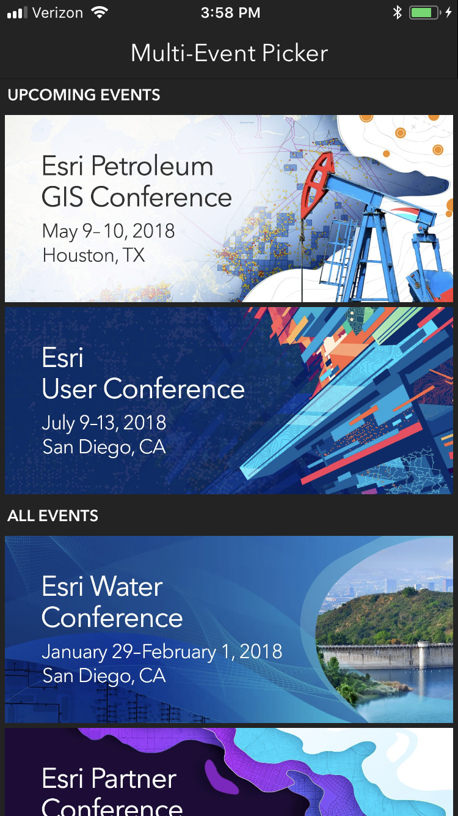
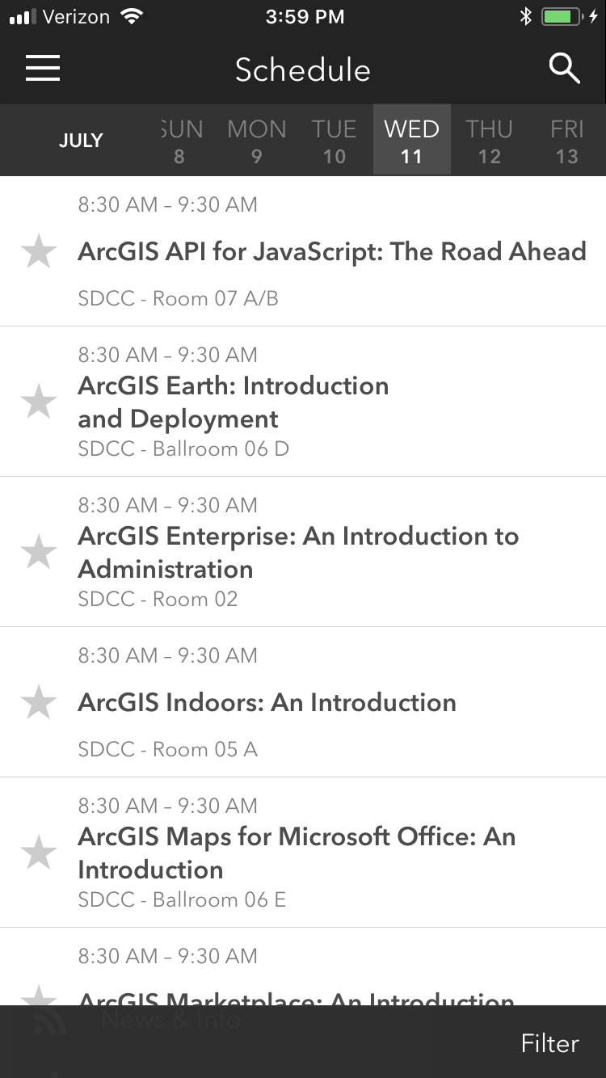
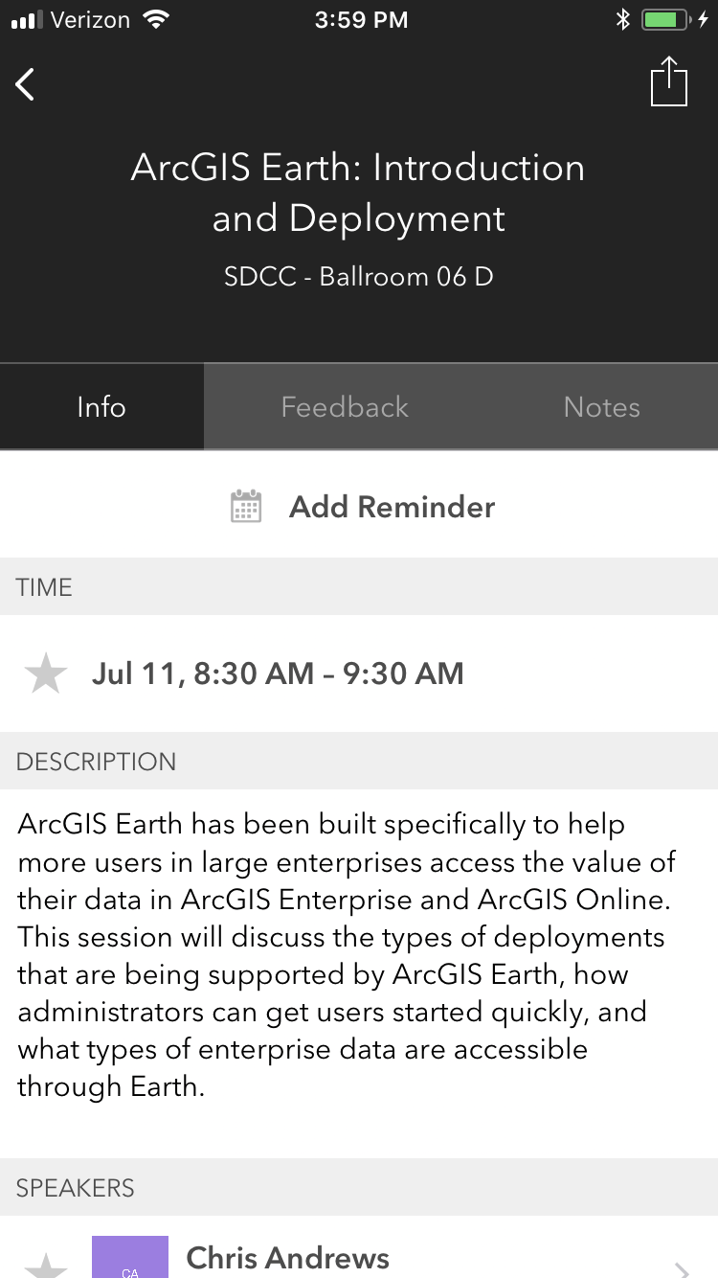
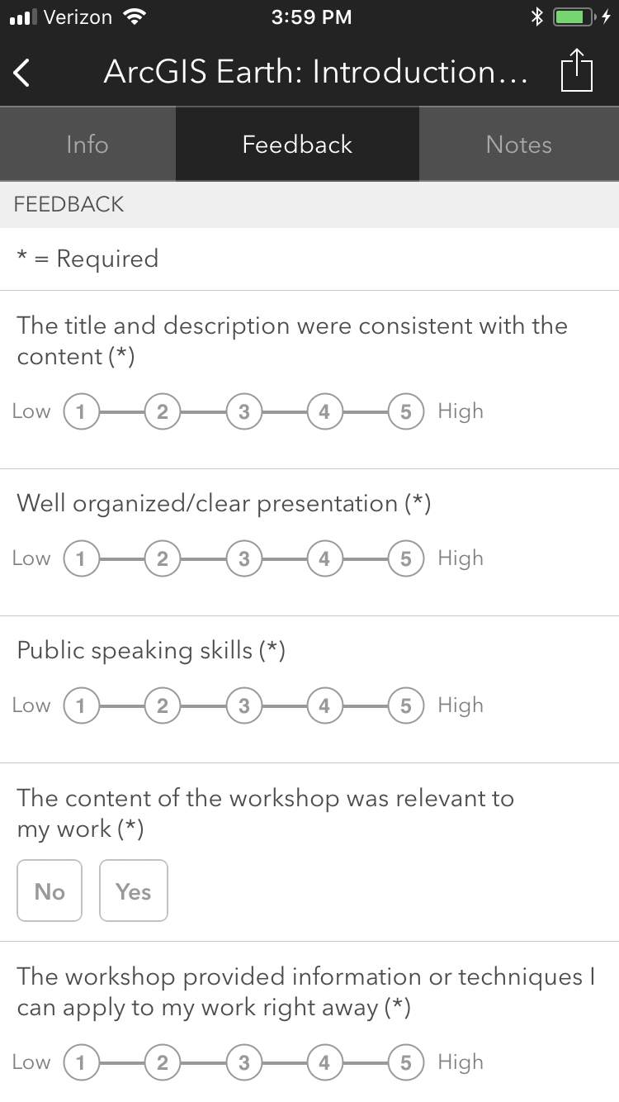
Please Take Our Survey on the App
Download the Esri Events app and find your event
Select the session you attended
Scroll down to find the feedback section
Complete answers
and select “Submit”

Slide 27
Presentation Title
Presenter Names
2019 ESRI DEVELOPER SUMMIT
Palm Springs, CA
Notes:
G243257 DevSummit 2019 Template for Esri staff

Slide 31
Click Here For DEMO
Sample Name Here

Slide 33
Please Take Our Survey on the App
Download the Esri Events app and find your event
Select the session you attended
Scroll down to find the feedback section
Complete answers
and select “Submit”

